Slide 1


Usman Arif
12-Oct-2022

Slide 2

Outline
Executive Summary
Introduction
Methodology
Results
Conclusion
Appendix

Slide 3
Executive Summary
Summary of methodologies
Data was Collected from SpaceX API & Wikipedia Page
Data wrangling was performed by dealing with null values & One Hot Encoding
EDA was performed using SQL
Data Visualization was created for EDA
Interactive Visualization & Dashboard were created
Predictive models were created for classification
Summary of all results
Visualizations helped in understanding Data
Optimal Predictive Model was obtained

Slide 4
Introduction
Project background and context
Reusage of first stage of Falcon 9 rocket launches help SpaceX to launch rocket at a reduced cost of 62 million dollars each, compared to 165 million dollars price tag of conventional launch.
Problems you want to find answers
Project task is to predict whether the first stage of SpaceX Falcon 9 rocket will land successfully or not.

Slide 5

Section 1

Slide 6
Methodology
Executive Summary
Data collection methodology:
Using SpaceX Rest API & Web Scrapping of Wikipedia
Perform data wrangling
Cleaning of Null values & Irrelevant columns & One Hot Encoding of data fields
Perform exploratory data analysis (EDA) using visualization and SQL
Perform interactive visual analytics using Folium and Plotly Dash
Perform predictive analysis using classification models
Different classification models were built using optimum parameters found by Grid Search to find optimal model for classification.

Slide 7
Data Collection
Describe how data sets were collected.
Data was collected using SpaceX API and Web scrapping. The process flow was as following
Using Space X Rest API
Requesting HTML From Wikipedia
Receiving JSON File from API
Extracting Data using beautiful soup
Normalizing data into csv file
Normalizing data into csv file
Combining Data for Consolidation and Wrangling

Slide 8
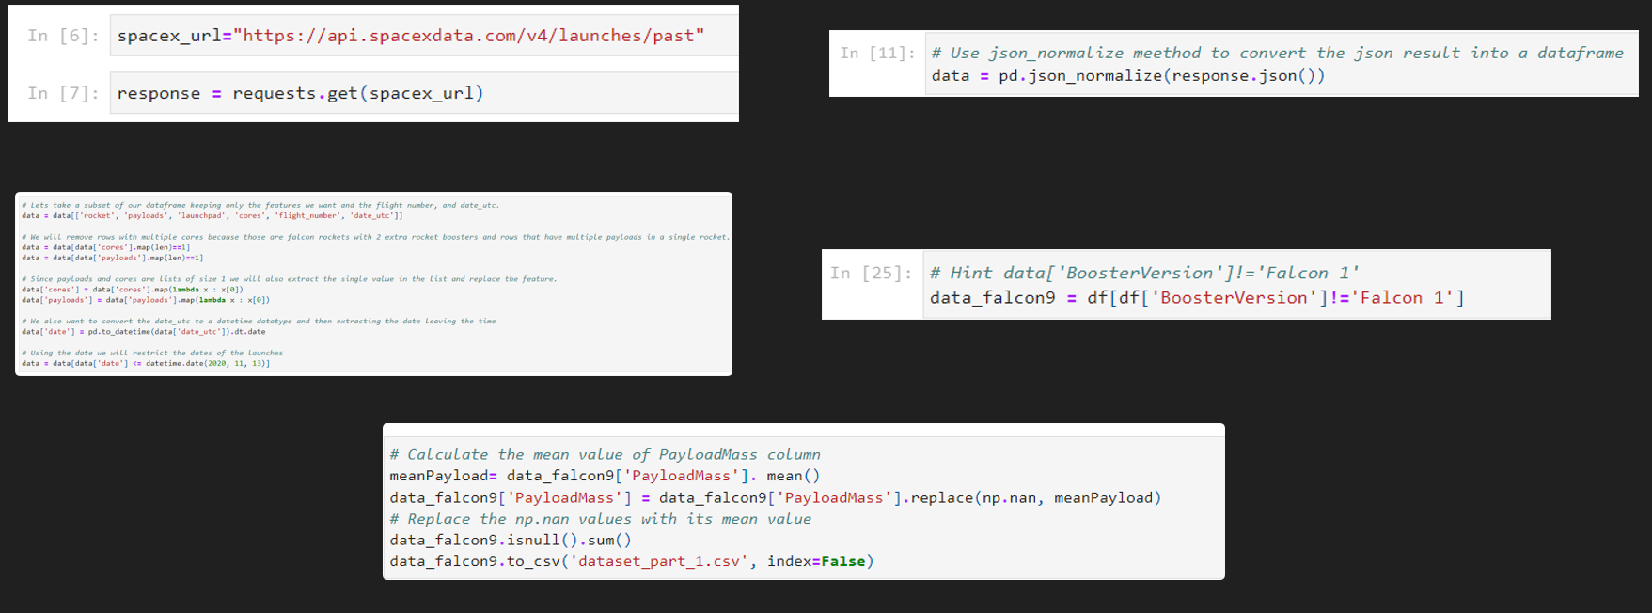
Data Collection – SpaceX API
Requesting Data from SpaceX API
Normalizing JSON File to Pandas Data Frame
Cleaning Data using Custom Functions
Extracting record for only Falcon 9 Rocket
Dealing with Null values & Exporting data As csv files
https://github.com/usmanarif1/Data-Science-Capstone-Project/blob/bbcf0ba7415607ce1e0c0d87fee40228dbb7b8b4/Space%20X%20data%20collection%20notebook.ipynb

Slide 9
Data Collection – SpaceX API
Requesting Data from SpaceX API
Normalizing JSON File to Pandas Data Frame
Cleaning Data using Custom Functions
Extracting record for only Falcon 9 Rocket
Dealing with Null values & Exporting data As csv files
https://github.com/usmanarif1/Data-Science-Capstone-Project/blob/bbcf0ba7415607ce1e0c0d87fee40228dbb7b8b4/Space%20X%20data%20collection%20notebook.ipynb

Slide 10
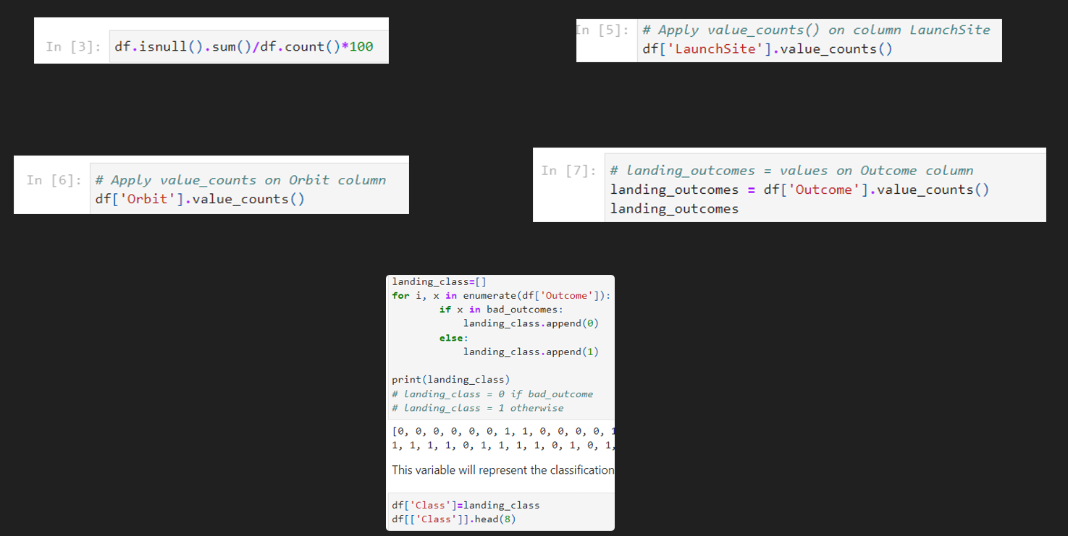
Data Wrangling
Calculating % of null values in each column
Calculating Number of launches on each site
Calculating number of occurrence of each orbit
Calculate number and occurrence of mission outcomes per orbit type
Create a landing outcome label
https://github.com/usmanarif1/Data-Science-Capstone-Project/blob/bbcf0ba7415607ce1e0c0d87fee40228dbb7b8b4/Space%20X%20data%20wrangling%20notebook.ipynb

Slide 11
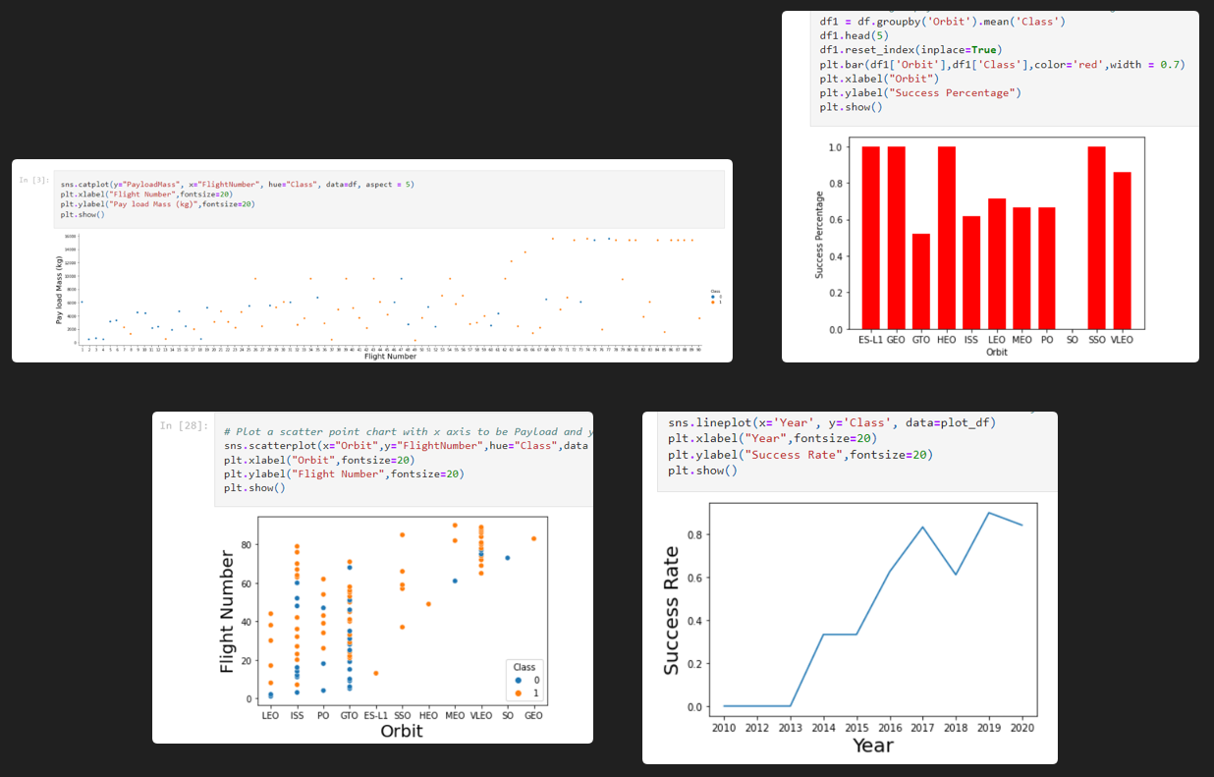
EDA with Data Visualization
Categorial Plots to see relationship between Fligh Number, Payload Mass, Orbit & Launch Site
Bar Plot to observe relationship between orbits and success percentage
Scatter Plot to observe relationship between flight number and orbit
Line Plot to observe relationship between year and success Rate
https://github.com/usmanarif1/Data-Science-Capstone-Project/blob/bbcf0ba7415607ce1e0c0d87fee40228dbb7b8b4/EDA%20with%20Data%20Visualization.ipynb

Slide 12
EDA with SQL
Display the names of the unique launch sites in the space mission
Display 5 records where launch sites begin with the string 'CCA’
Display the total payload mass carried by boosters launched by NASA (CRS)
Display average payload mass carried by booster version F9 v1.1
List the date when the first successful landing outcome in ground pad was achieved
List the names of the boosters which have success in drone ship and have payload mass greater than 4000 but less than 6000
List the total number of successful and failure mission outcomes
List the names of the booster_versions which have carried the maximum payload mass. Use a subquery
List the failed landing_outcomes in drone ship, their booster versions, and launch site names for in year 2015
Rank the count of landing outcomes (such as Failure (drone ship) or Success (ground pad)) between the date 2010-06-04 and 2017-03-20, in descending order
https://github.com/usmanarif1/Data-Science-Capstone-Project/blob/bbcf0ba7415607ce1e0c0d87fee40228dbb7b8b4/Exploratory%20Data%20Analysis%20using%20SQL.ipynb

Slide 13
Build an Interactive Map with Folium
Marker, Circle, Icon, Polynomial Line and markercluster were placed on Map.
These were used to mark launch sites on map, mark the success/ failed launches for each site on map and to calculate distances between launch site to its proximities
https://github.com/usmanarif1/Data-Science-Capstone-Project/blob/bbcf0ba7415607ce1e0c0d87fee40228dbb7b8b4/Data%20visualization%20with%20folium.ipynb

Slide 14
Build a Dashboard with Plotly Dash
Two interactions were added: Dropdown interaction for launch site & Slider interaction for Payload Mass
Two plots were added:
A success pie Chart linked to dropdown interaction
A success payload scatter Chart linked to both interactions
These plots and interactions were added to visualize relationship and to drive insights from payload mass and launch site data with success of the mission
https://github.com/usmanarif1/Data-Science-Capstone-Project/blob/bbcf0ba7415607ce1e0c0d87fee40228dbb7b8b4/spacex_dash_app.py

Slide 15
Predictive Analysis (Classification)
Created an array from the variable to be predicted ‘Class’.
Standardized the data set to be used for modeling
Train Test split of Data Set
Tuned Hyper Parameters for logistic regression, Decision tree, Support Vector Machines and K nearest Neighbor using Grid CV to achieve their maximum accuracy.
Predicted output variable using tuned models.
Plotted confusion matrix for the predicted values of different models.
https://github.com/usmanarif1/Data-Science-Capstone-Project/blob/bbcf0ba7415607ce1e0c0d87fee40228dbb7b8b4/Machine%20Learning.ipynb

Slide 16
Results
Exploratory data analysis results
Interactive analytics demo in screenshots
Predictive analysis results

Slide 17

Section 2

Slide 18
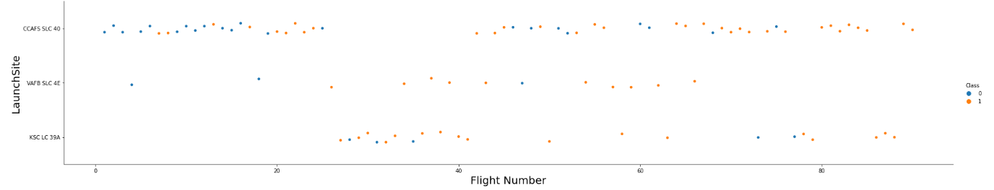
Flight Number vs. Launch Site
This scatter plot shows that most of the flights happened from launch site of CCAFS SLC 40

Slide 19
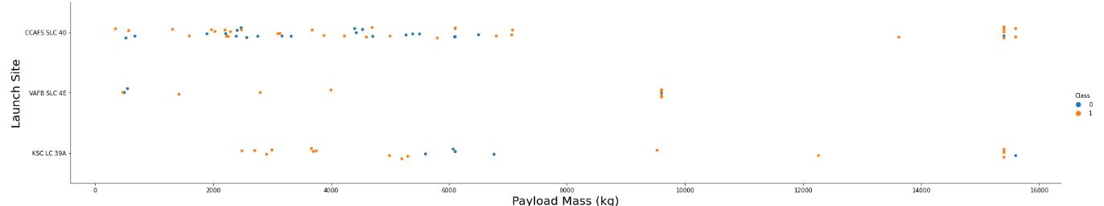
Payload vs. Launch Site
This Scatterplot shows that for payload greater than 10000kg VAFB SLC 4E launch site is not used.

Slide 20
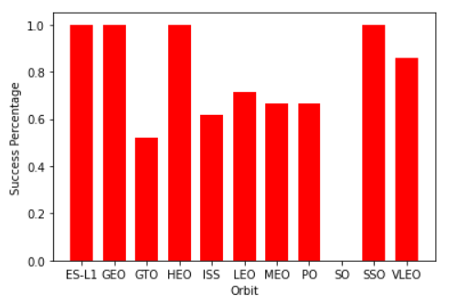
Success Rate vs. Orbit Type
This bar chart shows that for orbits: ES-L1, GEO, HEO & SSO success percentage of 100%

Slide 21
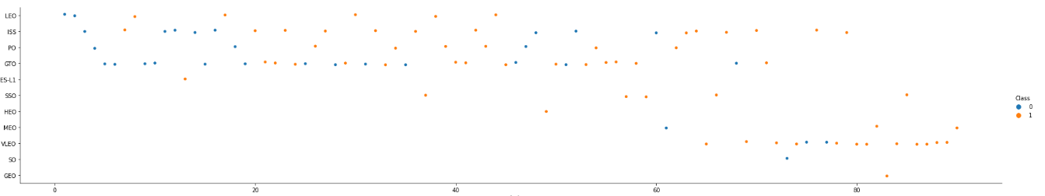
Flight Number vs. Orbit Type
Shows that later flight numbers are usually successfully launched in VLEO Orbit

Slide 22
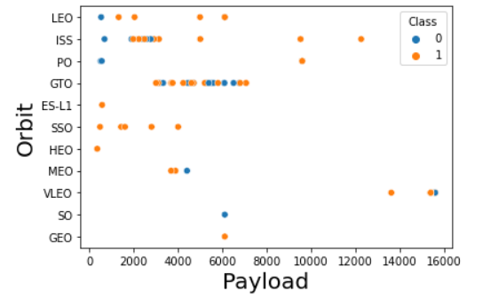
Payload vs. Orbit Type
It shows that for higher payloads ISS Orbit or VLEO orbit are preffered

Slide 23
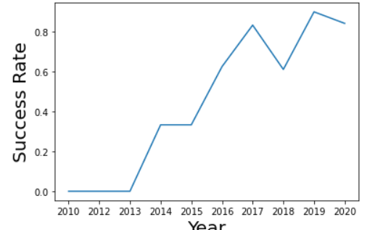
Launch Success Yearly Trend
This line plot shows that the trend of successful landing of booster is rising every year

Slide 24
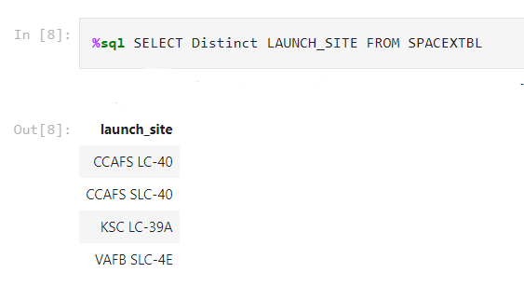
All Launch Site Names

Slide 25
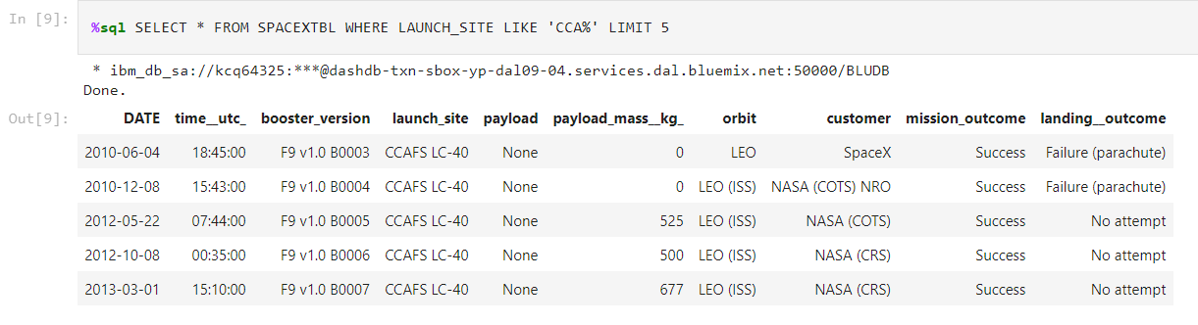
Launch Site Names Begin with 'CCA'

Slide 26
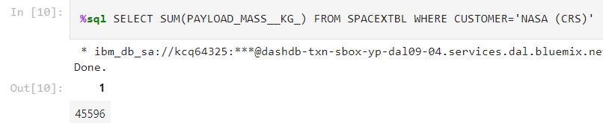
Total Payload Mass

Slide 27
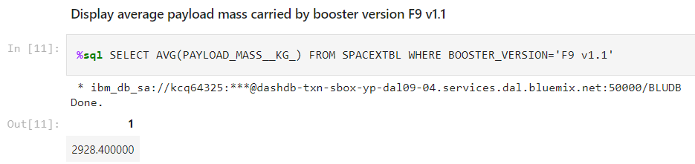
Average Payload Mass by F9 v1.1

Slide 28
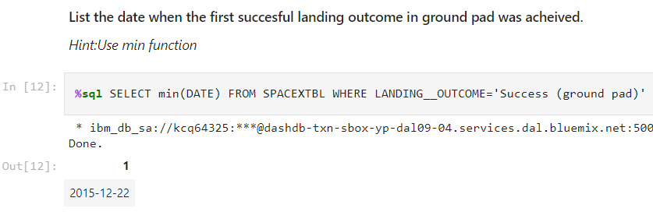
First Successful Ground Landing Date

Slide 29
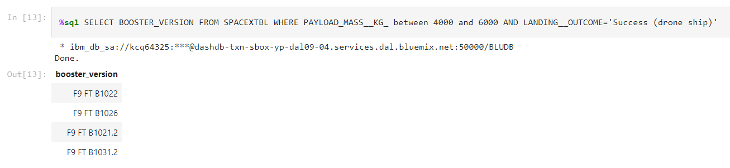
Successful Drone Ship Landing with Payload between 4000 and 6000

Slide 30
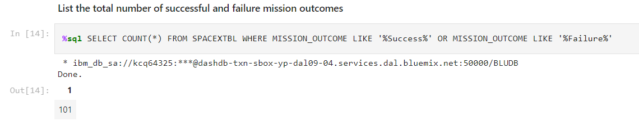
Total Number of Successful and Failure Mission Outcomes

Slide 31
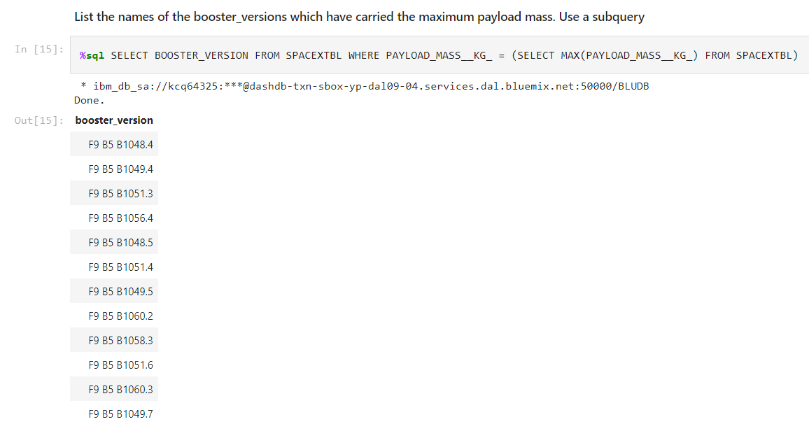
Boosters Carried Maximum Payload

Slide 32
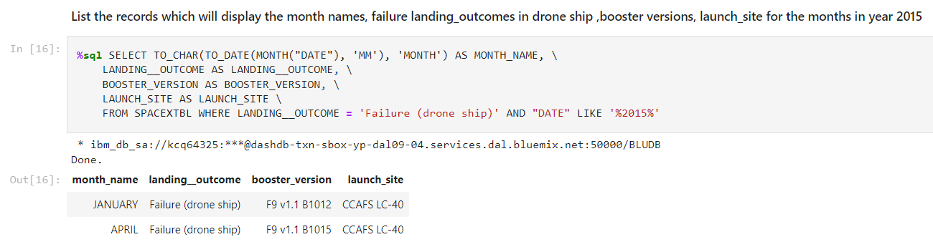
2015 Launch Records

Slide 33
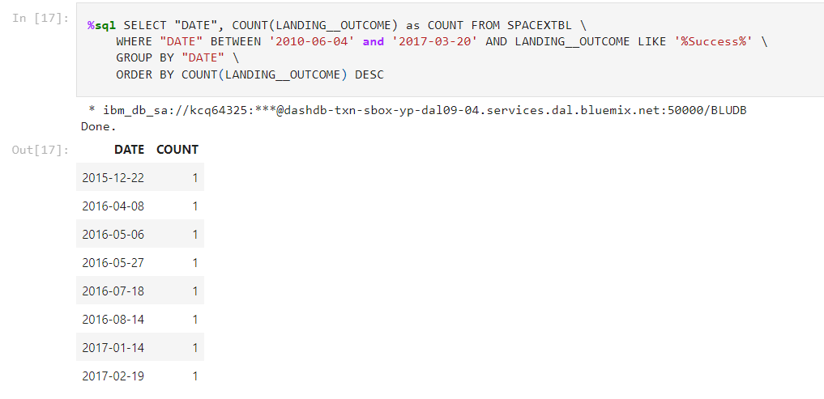
Rank Landing Outcomes Between 2010-06-04 and 2017-03-20

Slide 34

Section 3

Slide 35
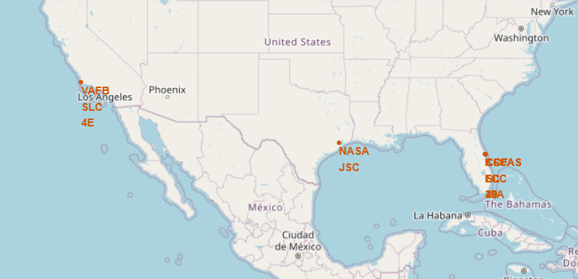
Launch Sites on Map

Slide 36
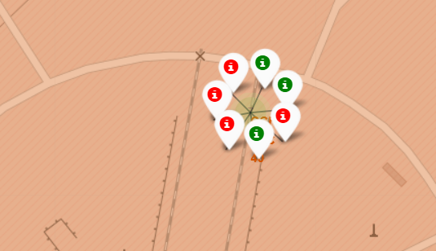
Outcomes from launch site
Green shows successful outcomes

Slide 37
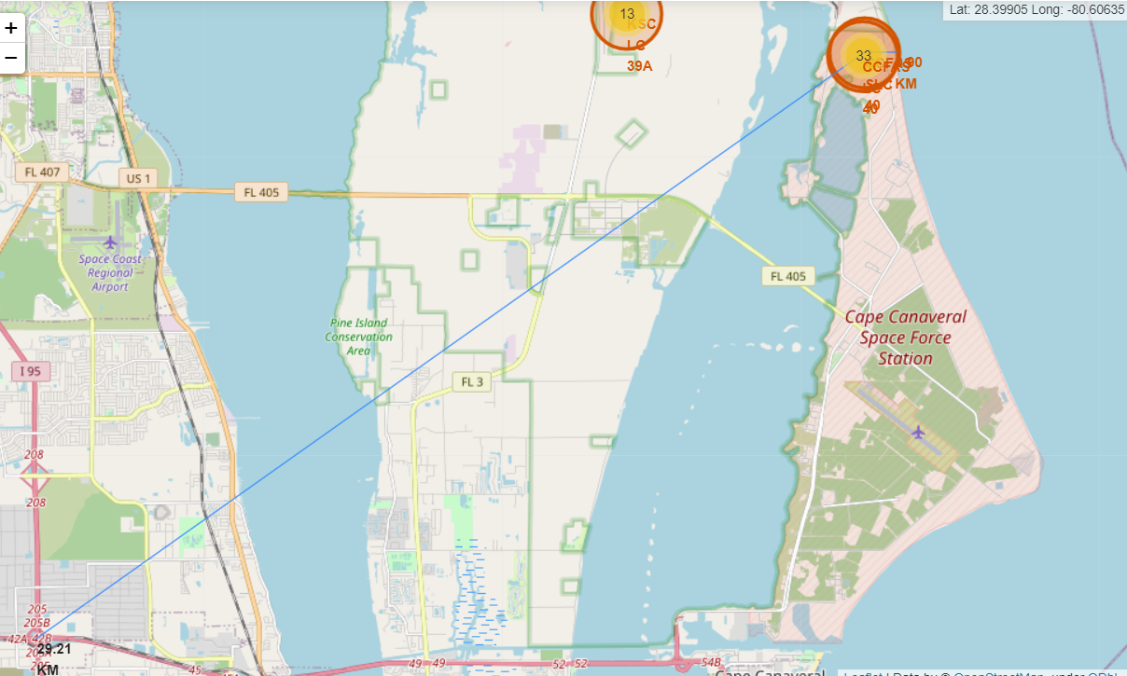
Proximity Distance from launch site

Slide 38

Section 4

Slide 39
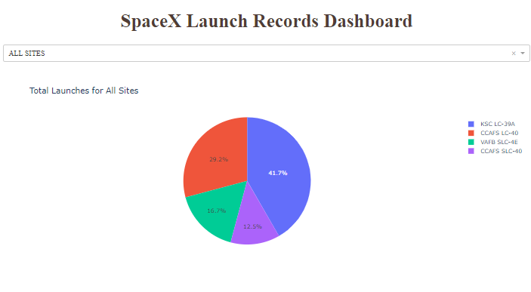
All Sites Pie Chart
Pie Chart shows percentage of launches from each launch site

Slide 40
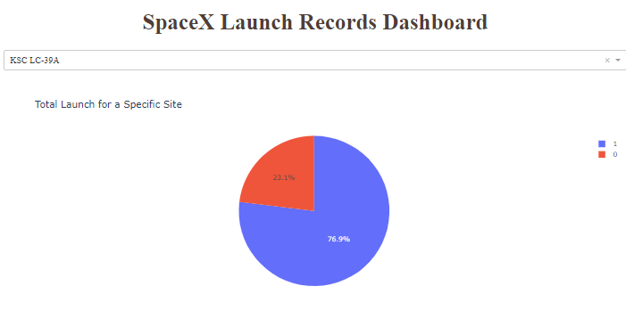
Highest launch success ratio
KSC LC-39A has highest launch success ratio with 76.9% as shown in pie chart

Slide 41
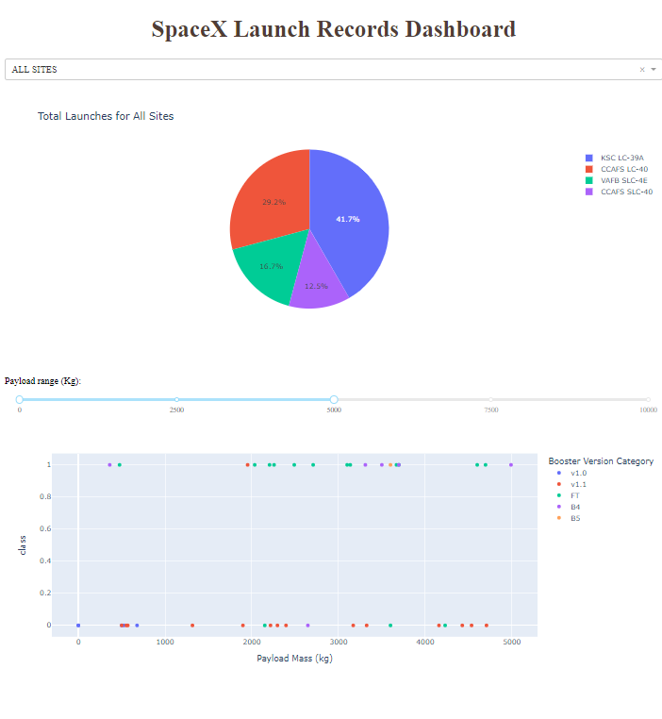
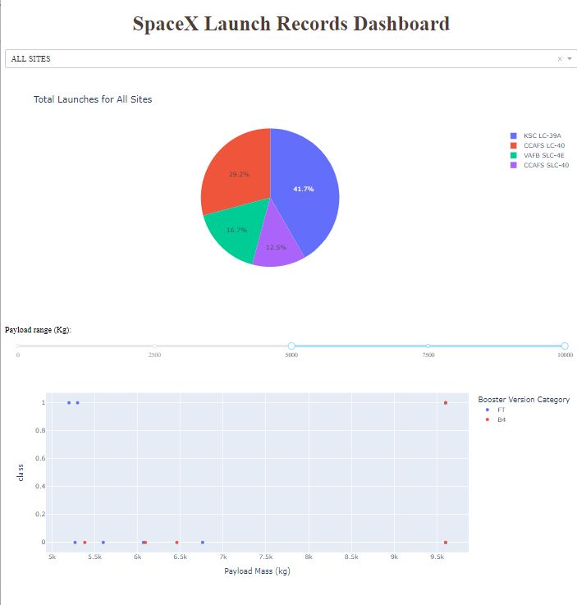
Payload vs Launch Outcome

Slide 42

Section 5

Slide 43
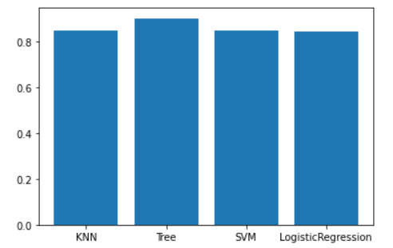
Classification Accuracy
The decision tree has the highest accuracy

Slide 44
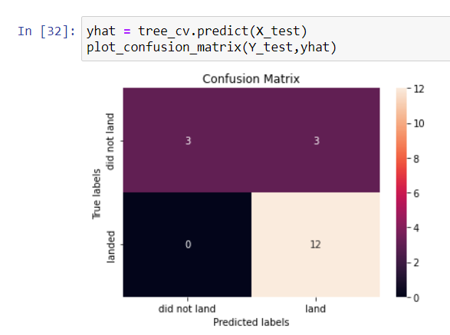
Confusion Matrix
Confusion matrix for decision tree

Slide 45
Conclusions
Decision Tree model has the highest accuracy of 0.90 approx.
Lighter payloads perform better than the heavier payloads
KSC LC-39A has highest success in launch
Success rate is increasing annually which will eventually lead to perfection
GEO, HEO , SSO & ES L1 orbits have highest accuracy.
Distance of any point from launch site can be calculated using interactive map

Slide 46
Appendix
Complete project link Github:
https://github.com/usmanarif1/Data-Science-Capstone-Project.git

Slide 47


